Slide 1
Welcome to: BASIC FIRST AID COURSE & TRAINING

Slide 2
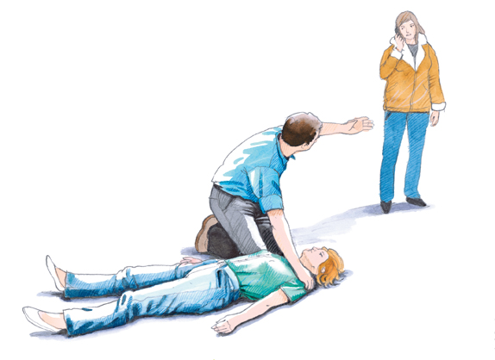
First aid during cardiac arrest
Duration: 3 hours

Slide 3
Competency goals
The participant can, both independently and in collaboration with others, handle an adult unconscious person, with or without normal breathing, cf. ERC guidelines for basic resuscitation.
The participant can give relevant first aid to an adult who has foreign bodies in the airways, cf. ERC guidelines for basic resuscitation.
The participant can recognize symptoms of stroke and provide appropriate first aid in case of stroke.
The participant can use a defibrillator where relevant for first aid.

Slide 4
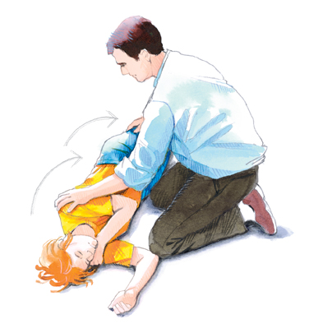
Course content
The 4 main objectives of first aid
The chain of survival
Recovery position
Resuscitation with and without defibrillators
Symptoms of heart attack
Foreign bodies in the respiratory tract
Handover to ambulance personnel
Practical training

Slide 5
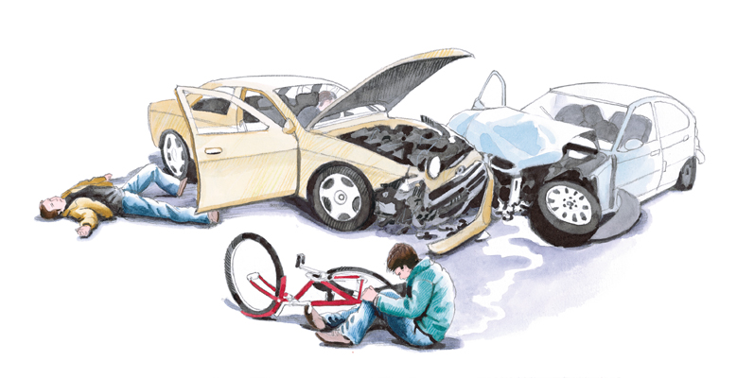
The 4 main objectives
Establish safe surroundings
Assess the person
Call for help
Give first aid

Slide 6
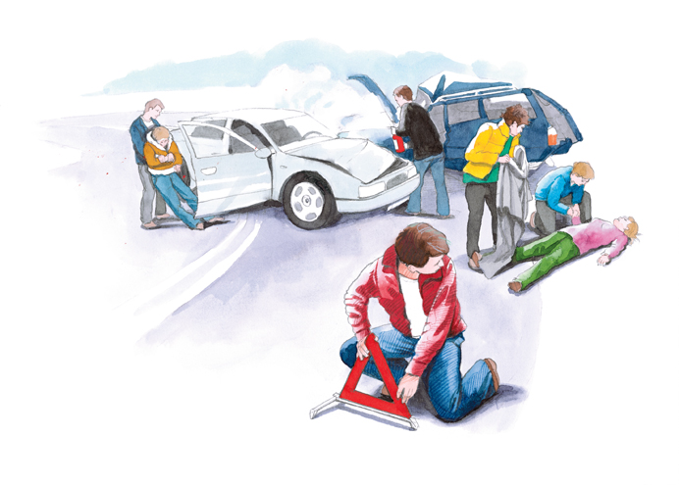
The 4 main objectives
Establish safe surroundings
Assess the person
Call for help
Give first aid

Slide 7
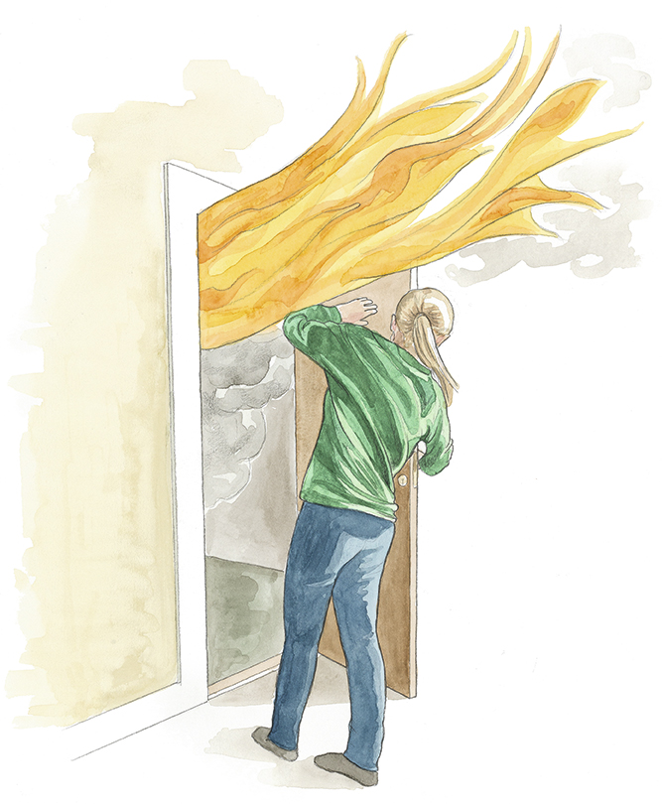
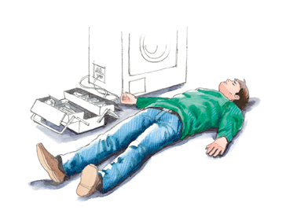
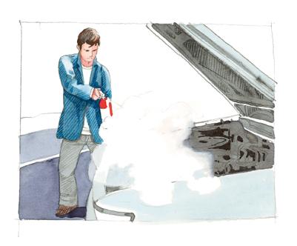
Establish safe surroundings
It is important to ensure the necessary safety, both for the injured, but also for those who help and for the paramedics.

Slide 8
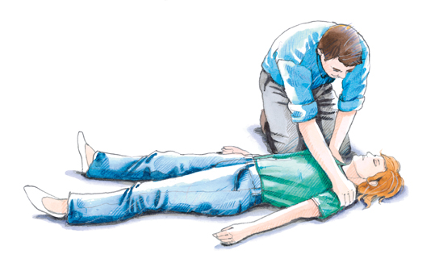
The 4 main objectives
Establish safe surroundings
Assess the person
Call for help
Give first aid

Slide 9
ABC approach
A Airway (Level of consciousness - free airways)
B Breathing ( Frequency – depth)
C Circulation (Bleeding - shock / circulatory failure)
If a problem is found, it must be solved before moving on to the next point.
Repeat assessment of A-B-C at appropriate intervals to detect a change in the person's condition.
Also use the ABC rule when handing over the
Person to rescue and ambulance personnel.

Slide 10
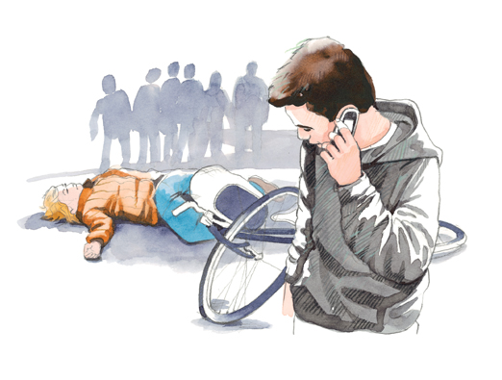
The 4 main objectives
Establish safe surroundings
Assess the person
Call for help
Give first aid

Slide 11
Call for help
Call 1-1-2
Calmly answer the alarm operator's questions
What happened?
Where did it happen?
How many injured (extent of damage)
Which phone number is called from
Stay on the phone until the alarm operator ends the call.

Slide 12
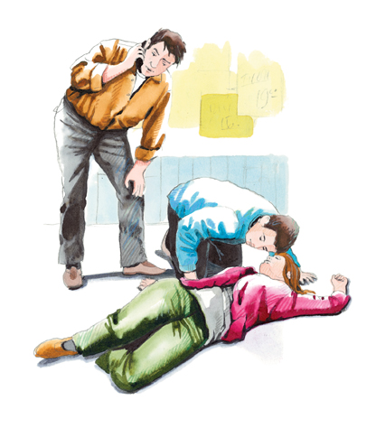
Call for help
If an ambulance is needed, you will be referred to a healthcare professional (nurse or paramedical staff).
Use their knowledge if you are in doubt about the person's symptoms.
Take advantage of their opportunity to guide you in first aid.
The alarm operators are happy to stay on the phone until you feel comfortable with the situation.
In some cases where the situation is not considered so serious, the alarm operator can refer to other relevant help (own doctor - the region's emergency telephone, etc.)

Slide 13
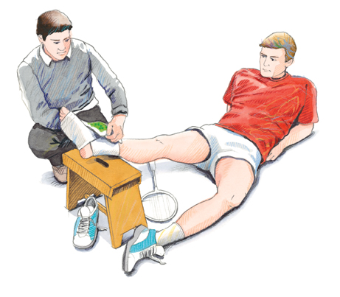
The 4 main objectives
Establish safe surroundings
Assess the person
Call for help
Give first aid

Slide 14
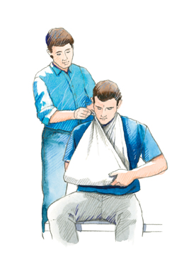
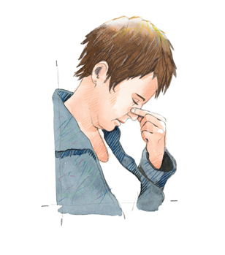
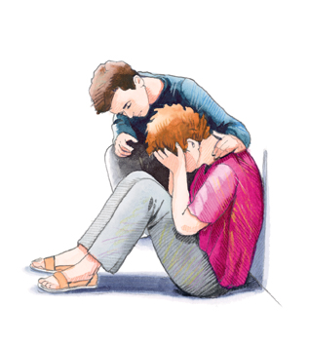
Give first aid
The first aid training provided here is not directly life-saving but necessary to help the sick / injured.

Slide 15
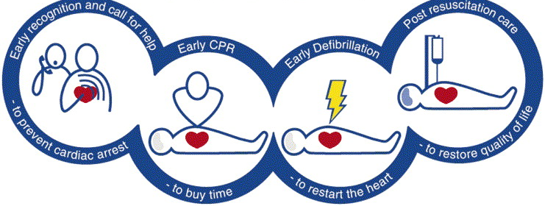
The chain of survival
There are between 3,500 and 4,000 cardiac arrests per year that require the help of a first aider.
To provide the optimal chance of survival for the person with cardiac arrest, all four links in the chain should preferably be connected.

Slide 16
Unconcious person with normal breathing
Examine level of consciousness
(awake - dizzy - asleep - unconscious)
Examine for normal breathing
(<20 / min, snoring, shallow breathing, gasping breathing etc. is not normal breathing)
If the person is unresponsive but with normal breathing, place the person in
RECOVERY POSITION

Slide 17
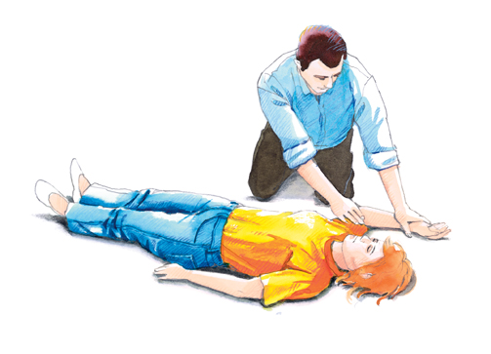
Recovery position

Slide 18
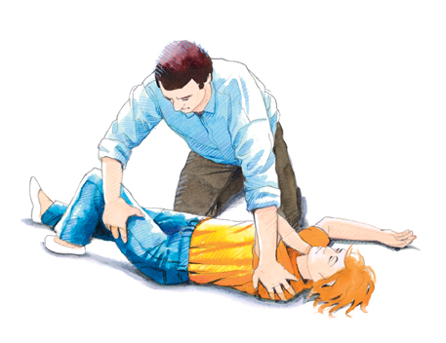

Slide 21
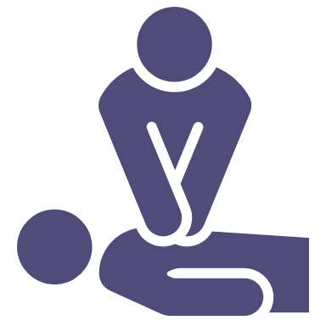
Unconcious person without normal breathing
Examine level of consciousness
(awake - dizzy - asleep - unconscious)
Examine for normal breathing
(<20 breaths / min, snoring, shallow breathing,
gasping breathing etc. is not normal breathing)
If the person is unresponsive and without normal breathing, start
CARDIOPULMONARY
RESUSCITATION

Slide 22
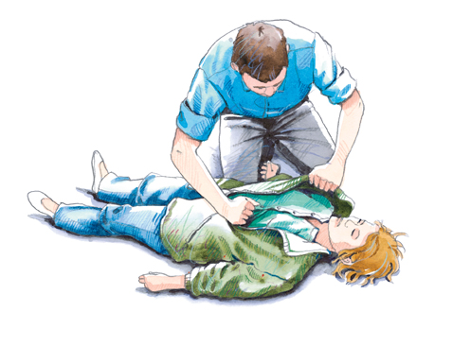
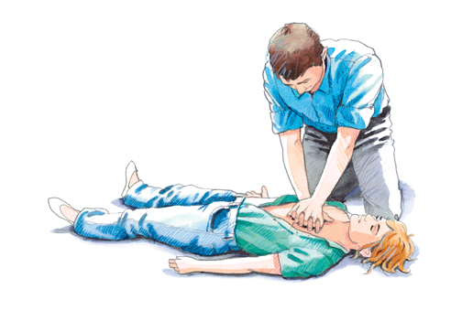
CPR for adults
Place the person on a hard surface (on the floor or ground)
Remove clothing from the person's chest (cut - tear - rip)
Designate the pressure point and place two fingers / heel of hand on the pressure point.
Place the other hand on top of the first and stretch the arms completely.
Lean over the person and press straight down.

Slide 23
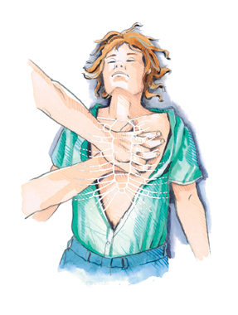
CPR for adults
Pressure depth for adults is 5-6 cm.
The rhythm is 30 compressions at the pressure point and then 2 breaths (mouth to mouth / nose)
The frequency must be 100 - 120 beats per minute.
Be careful not to "rest" on the chest while inhaling.

Slide 24
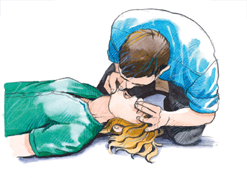
CPR for adults
Inhalations are preferably given using the mouth-to-mouth method.
Gently pull the head and jaw back´ until you encounter natural resistance.
(See drawing.)
Pinch nose with your thumb and forefinger.
Place your lips around the person's mouth.
Blow air into the person until the chest rises.

Slide 25
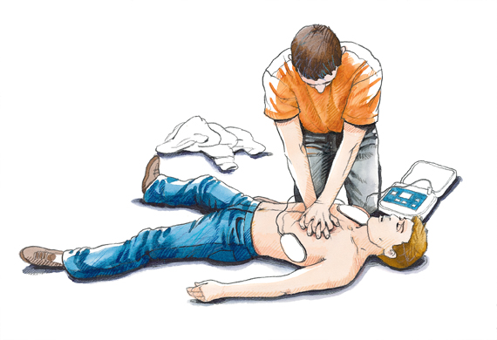
Defibrillator

Slide 26
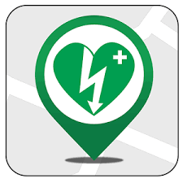
Defibrillator
Where can I find a defibrillator?
How do I use a defibrillator?
What can a defibrillator do?

Slide 27
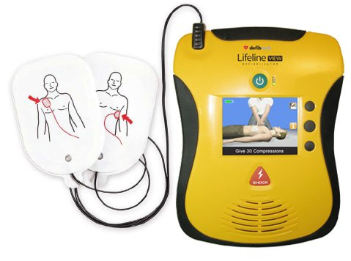
Defibrillator - Safety
Apply the electrodes to dry skin.
No metal or jewelry under the electrodes.
If a person is lying on a wet surface, you may also be electroshocked.
Do not touch the person while the defibrillator is analyzing.
Maintain firm skin contact. Remove dense hair growth on the chest if necessary.
Follow the defibrillator's instructions.

Slide 28
Defibrillator - Use
The defibrillator should be used as soon as one is available.
If there are two first aiders, one person continues with CPR until the other has prepared the defibrillator.
Alarmcentralen 1-1-2 or Trygfonden's defibrillator App can show the way to the nearest defibrillators.
If you are alone at a cardiac arrest, CPR should be given priority over finding a defibrillator.
Once a defibrillator has been in use, batteries and surge electrodes must be replaced. Contact the supplier.

Slide 29
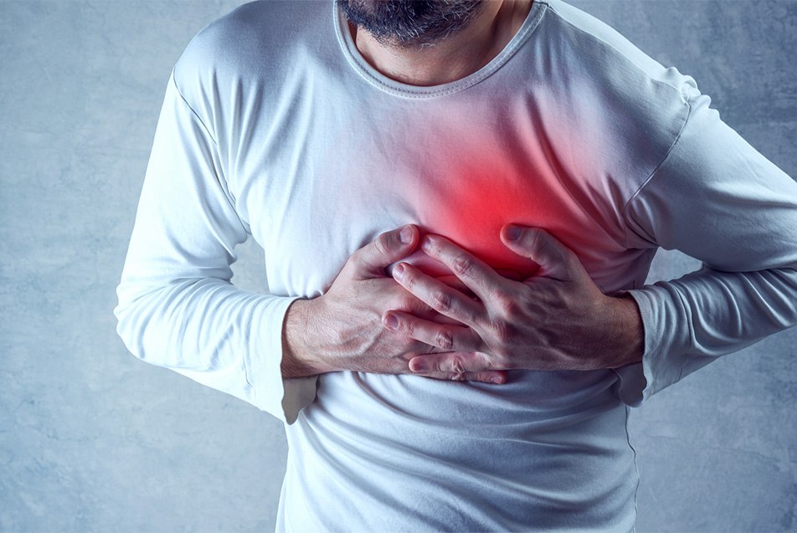
Symptoms of stroke
Middle chest pain and pressure, possibly travelling out to an arm (most often left arm), back or jaw.
Affected breathing (fast and shallow).
Pale or gray complexion, cold and sweaty.
Anxiety.
It is very individual how many of the symptoms are present.

Slide 30
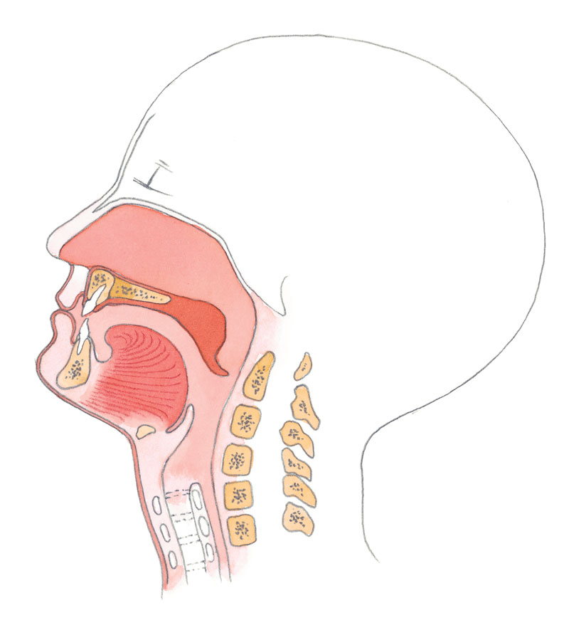
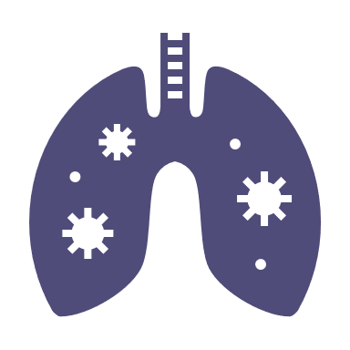
Foreign objects in the respiratory tract
Objects in the respiratory tract may completely or partially
block breathing.
This is a life threatening condition and first aid must be provided
immediately and while the person is still consciousness.

Slide 31
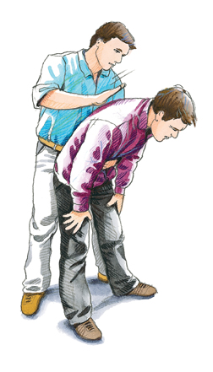
Foreign objects in the respiratory tract
Bend the person slightly forward and give 5 hard blows in the back / between the shoulder blades with a flat hand.

Slide 32
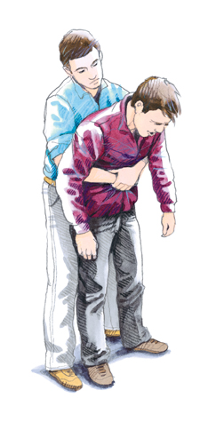
Foreign objects in the respiratory tract
If the 5 strokes to the back do not have the desired effect, continue with the Heimlich method.
Grasp the person from behind, make a fist with one hand with your thumb facing inwards just above the navel. Place the other hand flat over the clenched hand and give 5 hard blows to the abdominal cavity up against the diaphragm.
Give the blows at 2-3 second intervals.
If the person becomes unconscious, CPR must be started.

Slide 33
Diseases of the central nervous system
Stroke:
Stroke is a term that covers blood clots in the brain and cerebral hemorrhage. Symptoms and first aid are the same for each and the two conditions are indistinguishable to a first aider.
Symptoms:
Headache (often very severe headache)
Paralysis of the face and / or one side of the body
Difficulty speaking / difficulty swallowing
Explosive vomiting
Blurred, foggy, conscious

Slide 34
Stroke
First aid:
Use the ABC rule and remedy any. critical conditions (free airways, breathing problems, etc.)
If necessary, begin giving CPR.
Call for help (quick medical evaluation is important for starting correct treatment).
Psychological first aid and observe the person closely.

Slide 35
Handover to ambulance personell
Objective assessment: What you have seen yourself, what can you ascertain from the person, what do you find at the location, etc.
Subjective statements: What can the environment show you, what can other people tell you, is there anything that indicates something?
What first aid have you provided and what has the effect been: the ABC method, the Heimlich method, recovery position, CPR, etc.

Slide 36
Questions
?

